Slide 1


Scientific Machine Learning
Lecture 12: Learning numerical schemes for PDEs via deep learning
孟旭辉
数学与统计学院数学与应用学科交叉创新研究院
办公室：欣苑2栋111室
Email：xuhui_meng@hust.edu.cn
https://github.com/XuhuiM/SciML-Course

Slide 2
Contents
Brief review on FDM/FVM
Learning numerical schemes from data
Applications to PDEs
…

Slide 3
Contents
Brief review on FDM/FVM
Learning numerical schemes from data
Applications to PDEs
…

Slide 4
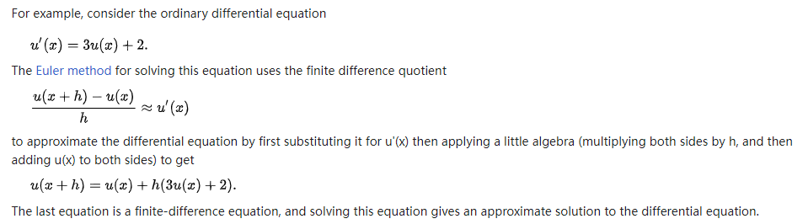
Finite Difference Method (FDM)
From Wiki

Slide 5
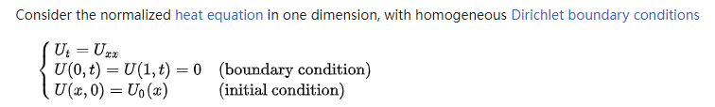
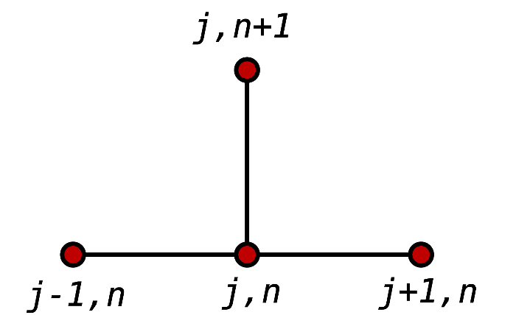
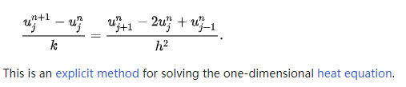
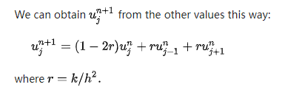
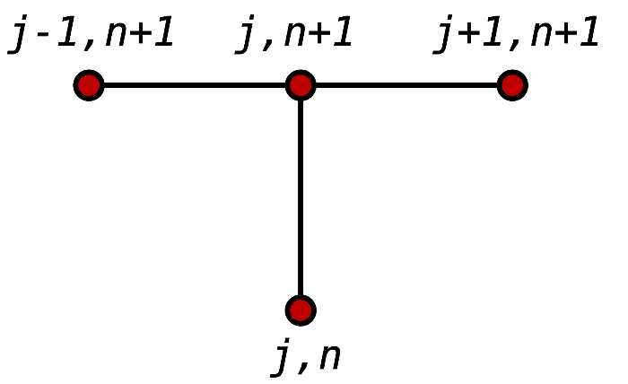
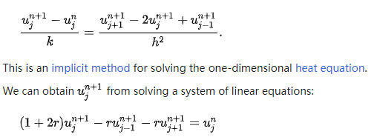
Finite Difference Method (FDM)
From Wiki

Slide 6
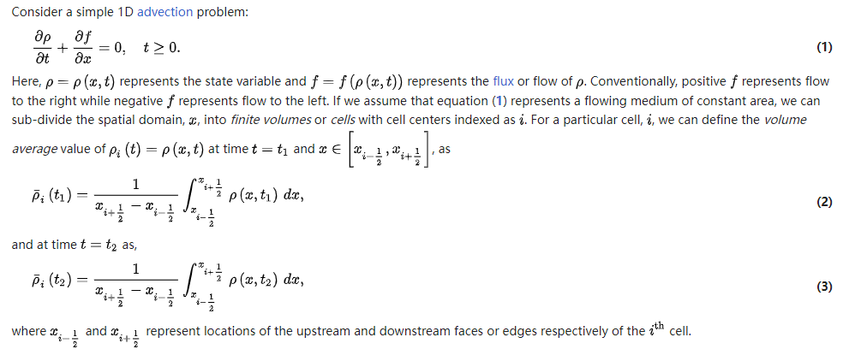
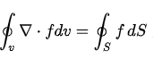
Finite Volume Method (FVM)
From Wiki

Slide 7
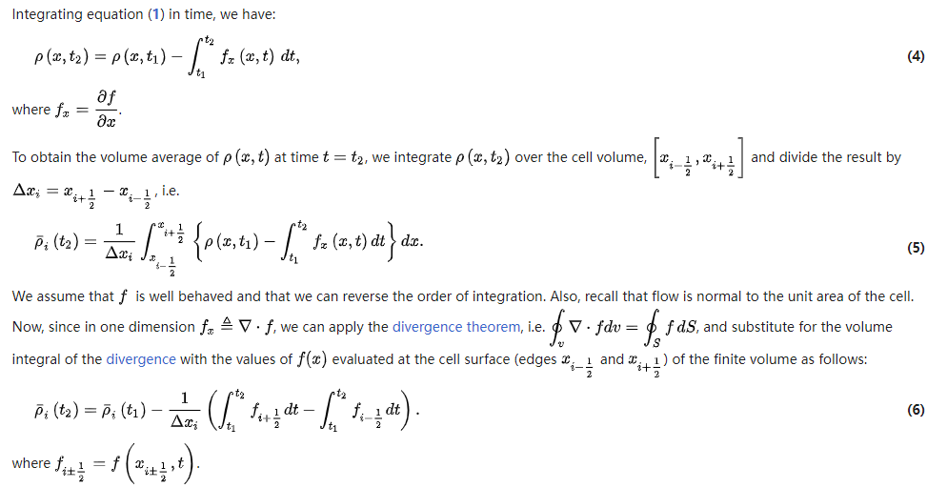
Finite Volume Method (FVM)
From Wiki

Slide 8
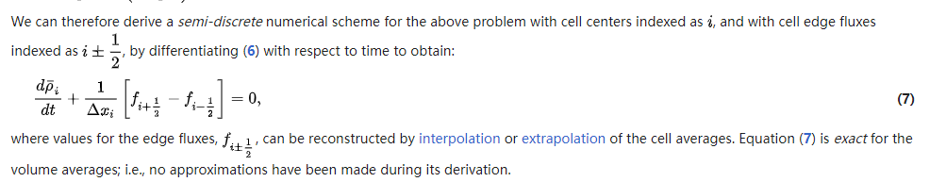
Finite Volume Method (FVM)
From Wiki

Slide 9
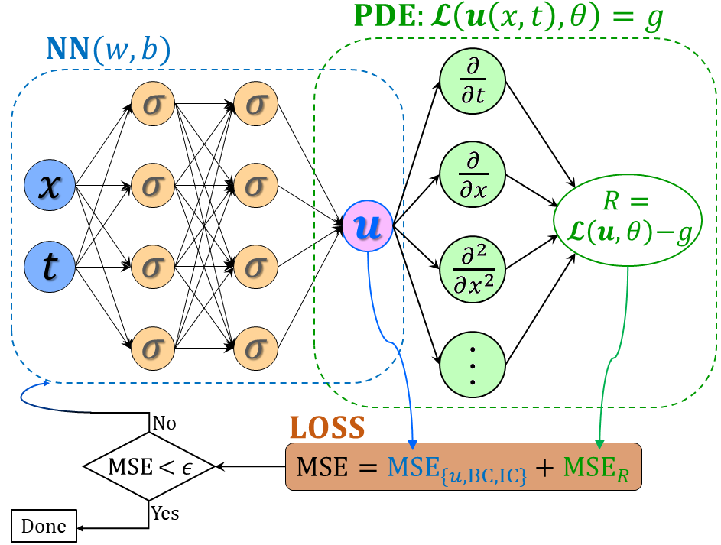
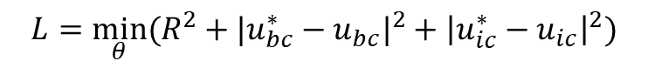

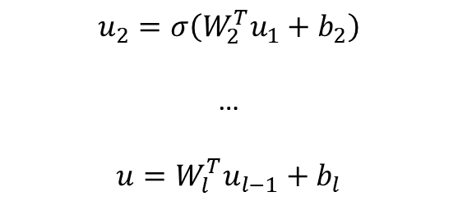

From DNNs to PINNs
$$u_{1}=σ(W_{1}^{T}X+b_{1})$$
(1)
$$u_{2}=σ\left(W_{2}^{T}u_{1}+b_{2}\right)$$
…
$$u=W_{l}^{T}u_{l−1}+b_{l}$$
(2) PDE part: Chain rule
$$∂_{t}u, ∂_{x}u, …$$
Physics-informed neural networks (PINNs)
Loss function:
Forward problem:
$$L={\min_{θ}⁡(R^{2}+|u_{bc}^{∗}−u_{bc}|}^{2}+{\left|u_{ic}^{∗}−u_{ic}\right|}^{2})$$
Inverse problem:
$$L={\min_{θ,λ}⁡(R^{2}+|u_{bc}^{∗}−u_{bc}|}^{2}+{\left|u_{ic}^{∗}−u_{ic}\right|}^{2}+{\left|u^{∗}−u\right|}^{2})$$
Raissi, et al, JCP, 2019
Meng, et al, CMAME, 2020

Slide 10
FDM-based PINNs
$$u_{1}=σ(W_{1}^{T}X+b_{1})$$
(1)
$$u_{2}=σ\left(W_{2}^{T}u_{1}+b_{2}\right)$$
…
$$u=W_{l}^{T}u_{l−1}+b_{l}$$
(2) PDE part: finite difference
$$∂_{t}u, ∂_{x}u, …$$
Physics-informed neural networks (PINNs)
Lim, et al, 2022

Slide 11
FDM-based PINNs
$$u_{1}=σ(W_{1}^{T}X+b_{1})$$
(1)
$$u_{2}=σ\left(W_{2}^{T}u_{1}+b_{2}\right)$$
…
$$u=W_{l}^{T}u_{l−1}+b_{l}$$
(2) PDE part: finite difference
$$∂_{t}u, ∂_{x}u, …$$
Physics-informed neural networks (PINNs)
Loss function:
Forward problem:
$$L={\min_{θ}⁡(R^{2}+|u_{bc}^{∗}−u_{bc}|}^{2}+{\left|u_{ic}^{∗}−u_{ic}\right|}^{2})$$
Inverse problem:
$$L={\min_{θ,λ}⁡(R^{2}+|u_{bc}^{∗}−u_{bc}|}^{2}+{\left|u_{ic}^{∗}−u_{ic}\right|}^{2}+{\left|u^{∗}−u\right|}^{2})$$
Raissi, et al, JCP, 2019
Meng, et al, CMAME, 2020

Slide 12
Contents
Brief review on FDM/FVM
Learning numerical schemes from data
Applications to PDEs
…

Slide 13
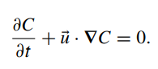
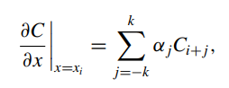
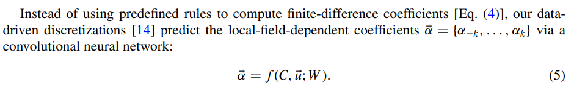
Learning numerical schemes from data
Zhuang, et al, PRF, 2021

Slide 14
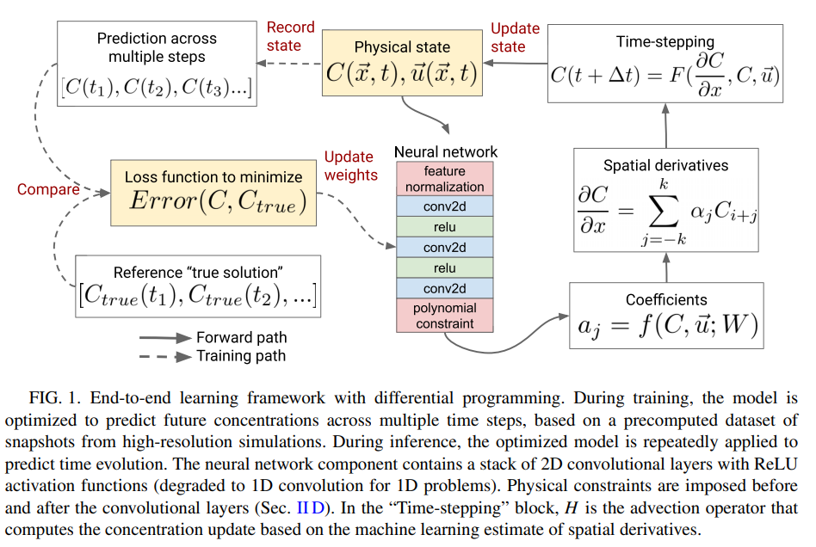
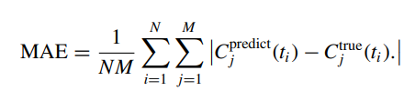
Learning numerical schemes from data
Zhuang, et al, PRF, 2021

Slide 15
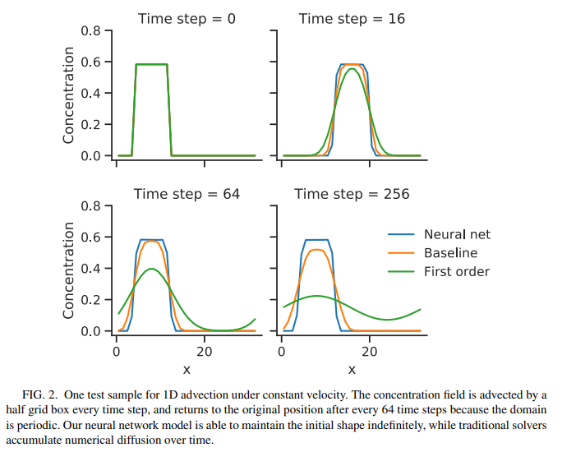
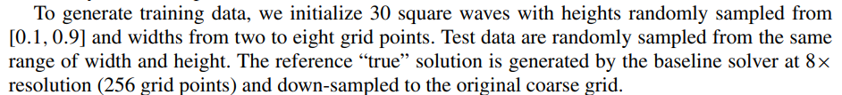
Example: 1D advection equation
$α:$ 4 convolutional layers with 32 filters per layer
Zhuang, et al, PRF, 2021

Slide 16
Example: 1D advection equation
Zhuang, et al, PRF, 2021

Slide 17
Example: 1D advection equation
Zhuang, et al, PRF, 2021

Slide 18
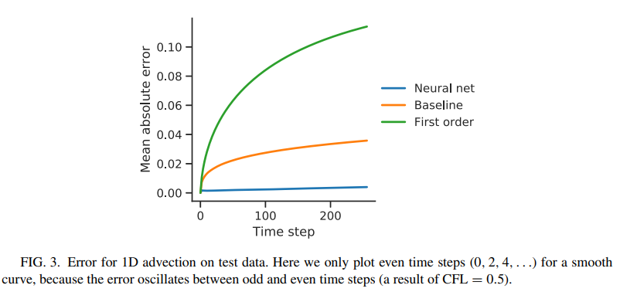
Example: 1D advection equation
Zhuang, et al, PRF, 2021

Slide 19
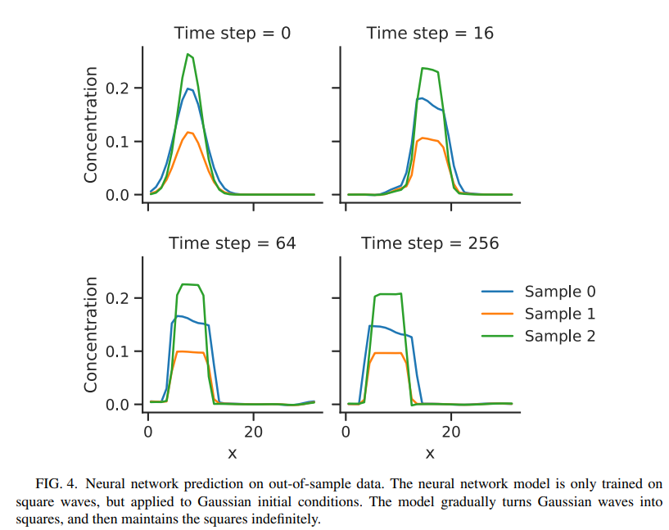
Example: 1D advection equation
Zhuang, et al, PRF, 2021

Slide 20
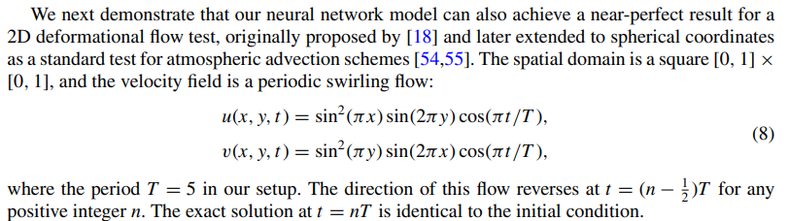
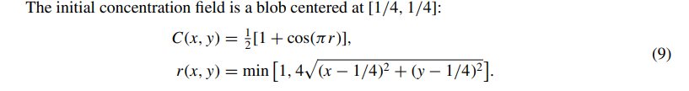
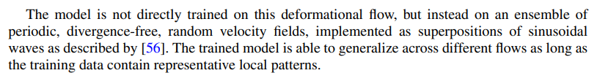
Example: 2D deformational flow
Zhuang, et al, PRF, 2021

Slide 21
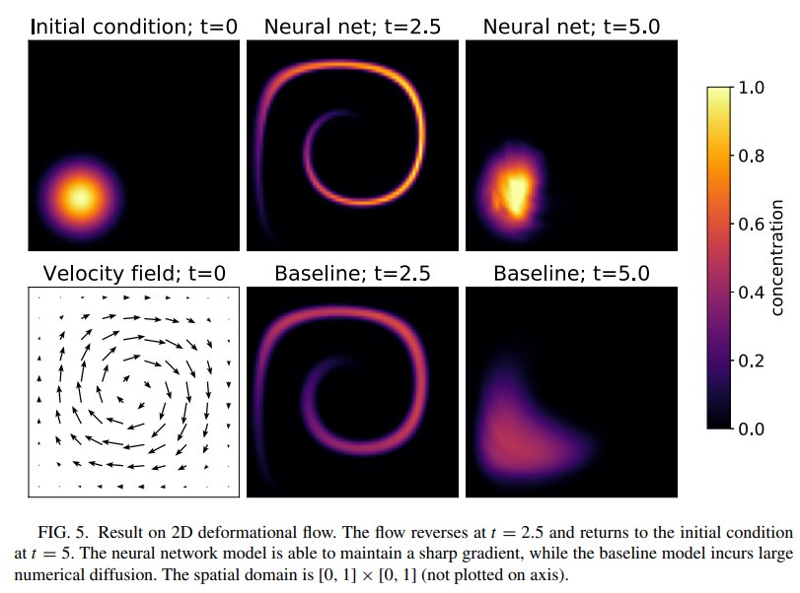
Example: 2D deformational flow
Zhuang, et al, PRF, 2021

Slide 22
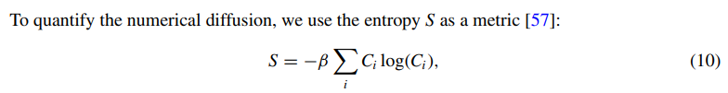
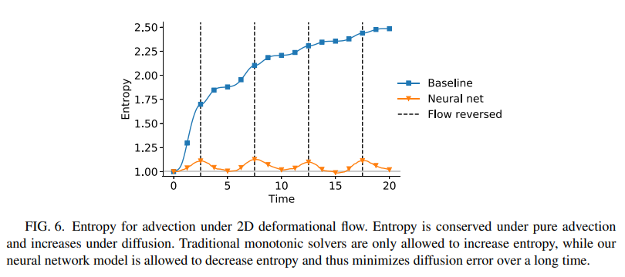
Example: 2D advection equation
Zhuang, et al, PRF, 2021

Slide 23
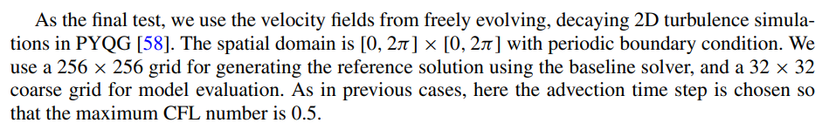
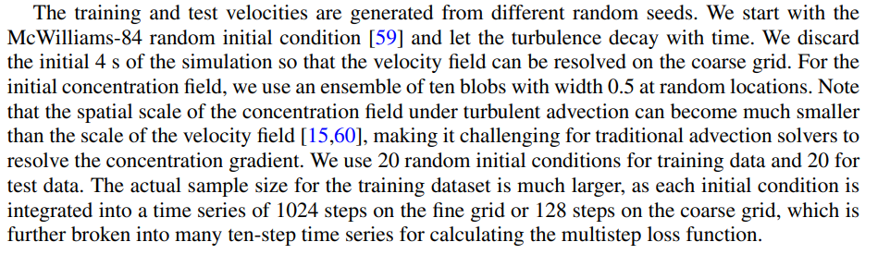
Example: 2D Turbulence
Zhuang, et al, PRF, 2021

Slide 24
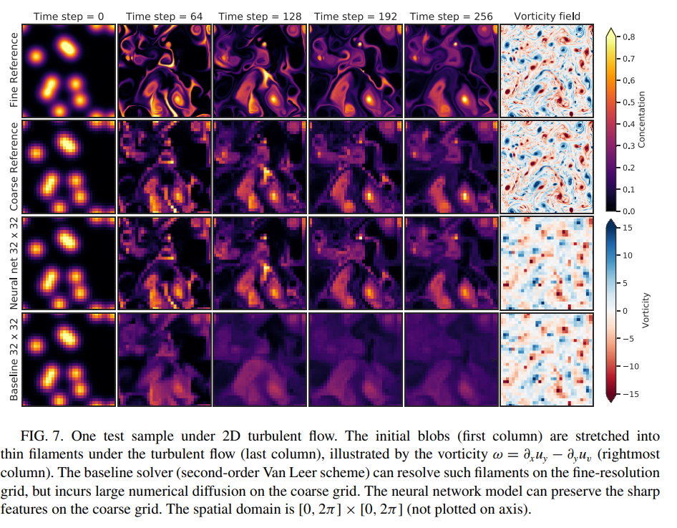
Example: 2D Turbulence
Zhuang, et al, PRF, 2021

Slide 25
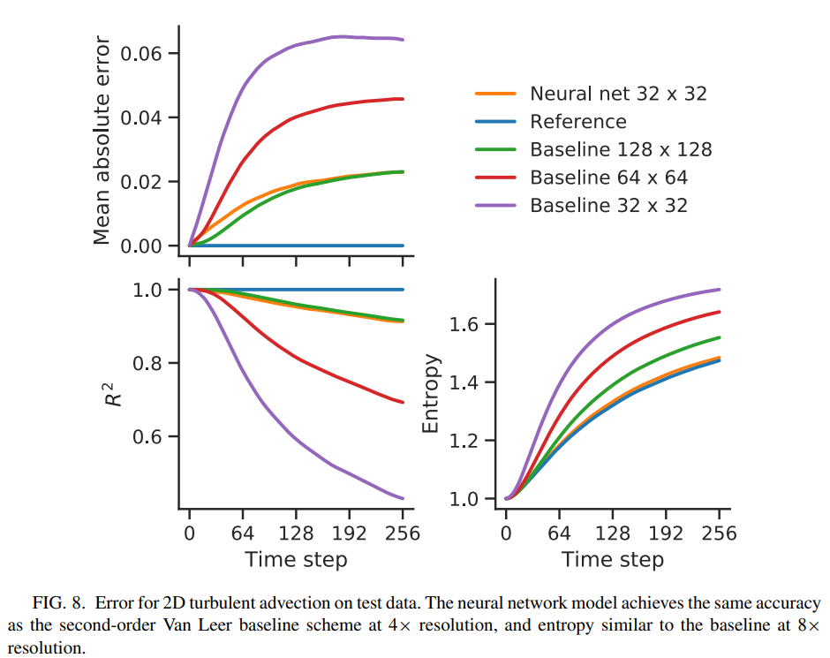
Example: 2D Turbulence
Zhuang, et al, PRF, 2021

Slide 26
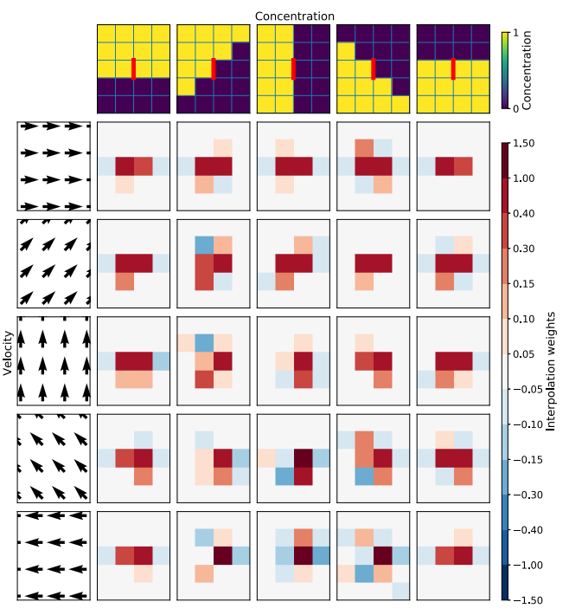
Example: 2D Turbulence
Zhuang, et al, PRF, 2021

Slide 27
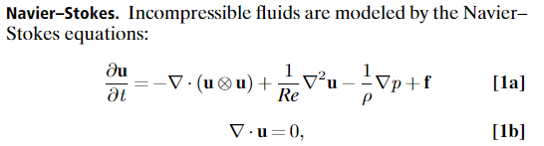
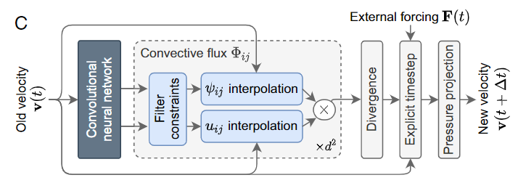
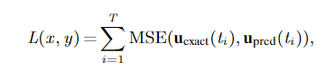
Example: Turbulence (FVM)
Kochkov, et al, PNAS, 2021

Slide 28
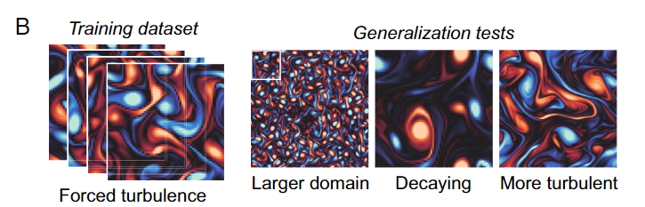
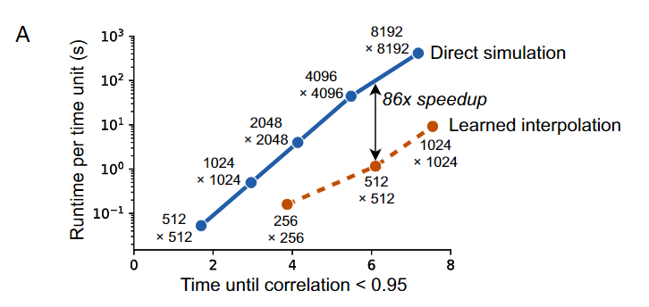
Example: Turbulence (FVM)
Kochkov, et al, PNAS, 2021

Slide 29
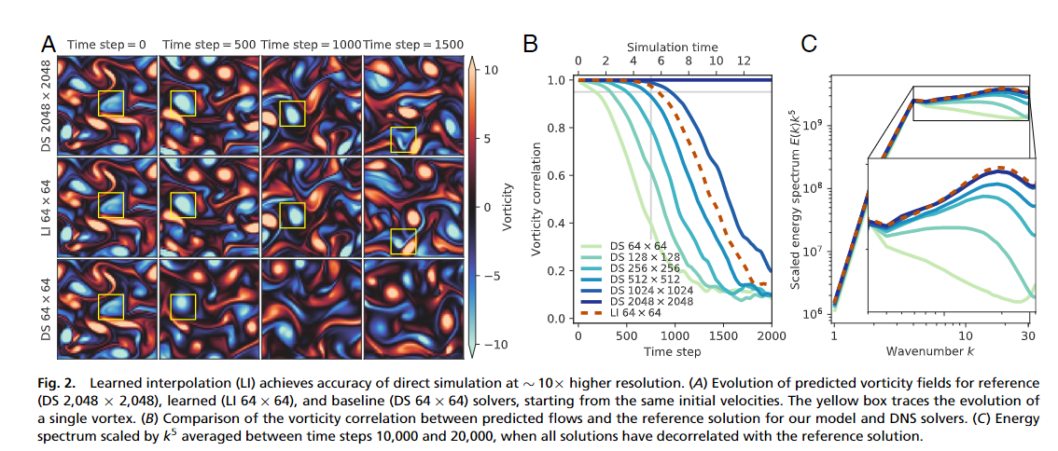
Example: Turbulence (FVM)
Kochkov, et al, PNAS, 2021

Slide 30
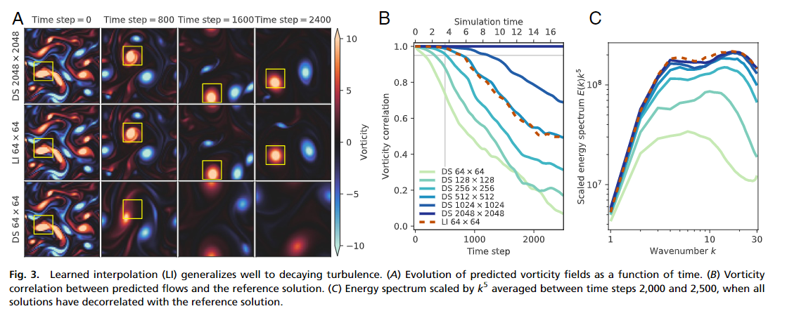
Example: Turbulence (FVM)
Kochkov, et al, PNAS, 2021

Slide 31
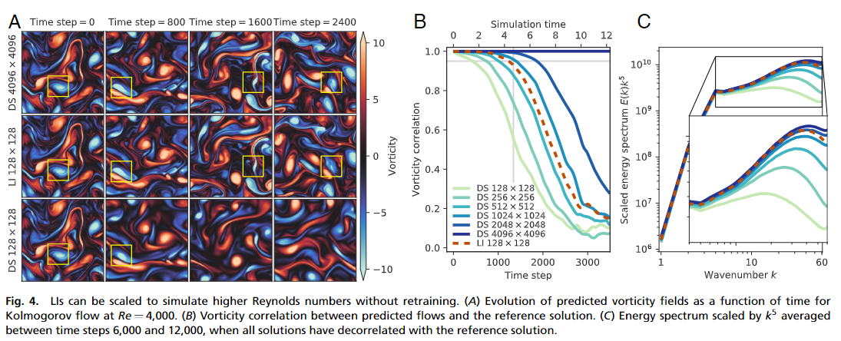
Example: Turbulence (FVM)
Kochkov, et al, PNAS, 2021

Slide 32

Thank you for your attention!

